Slide 1
Lazy Latte Art
Build a latte art machine by April 17, 2023 for $450
Integrated Systems Design II: Milestone II Demo
Elise Ferkler, Mariah Tam, Derrick Joyce, Jackie Bendziewicz, Leah Brown, Luke Swetonic
Electrical and Computer Engineering
Clemson University

Slide 2
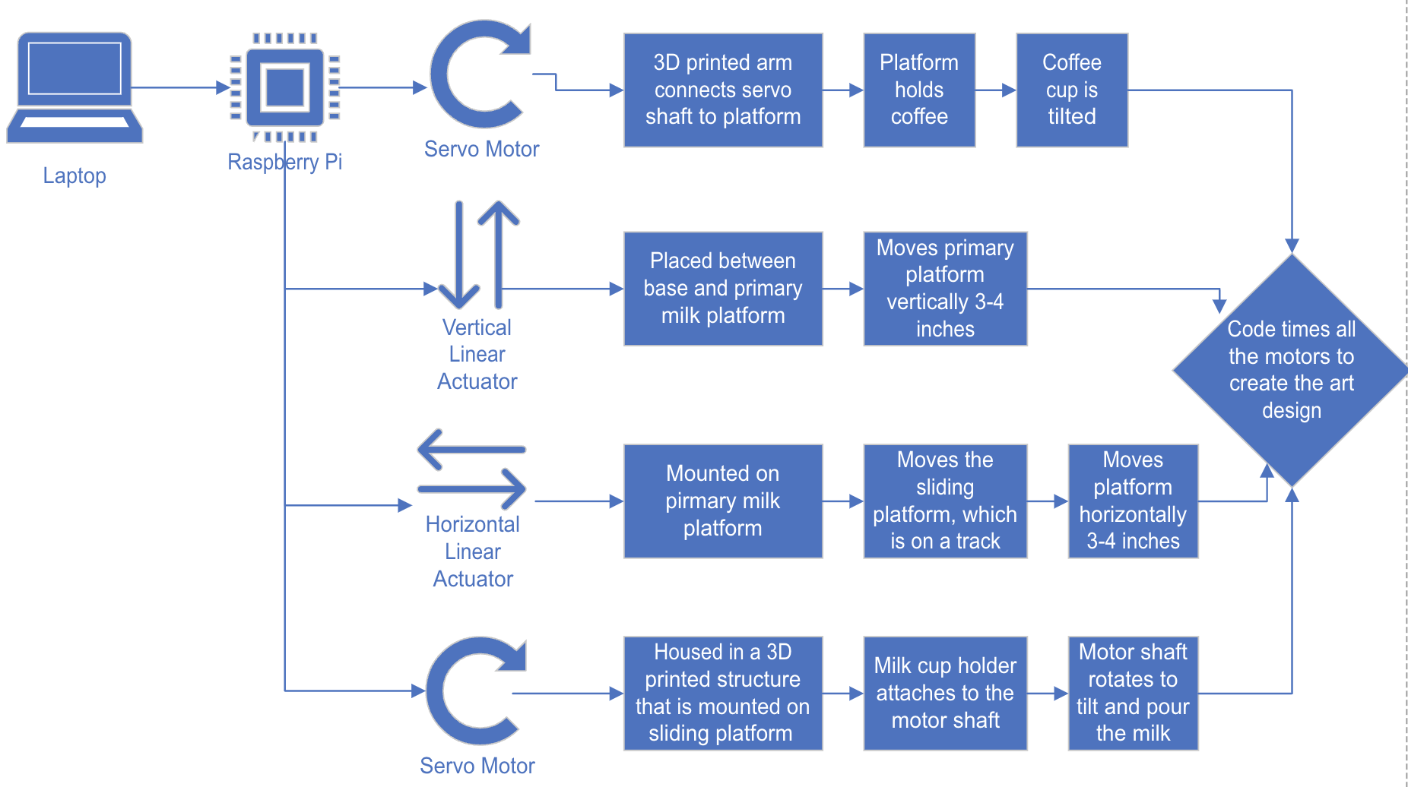
Block Diagram

Slide 3
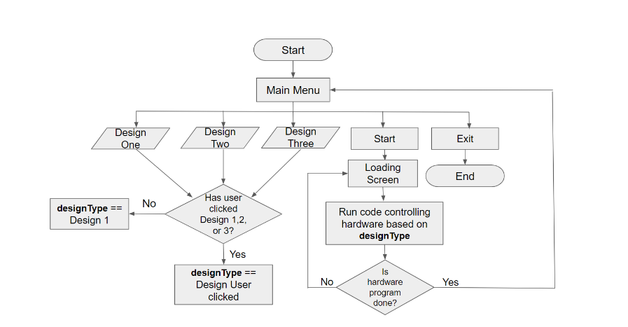
GUI Flow Chart

Slide 4
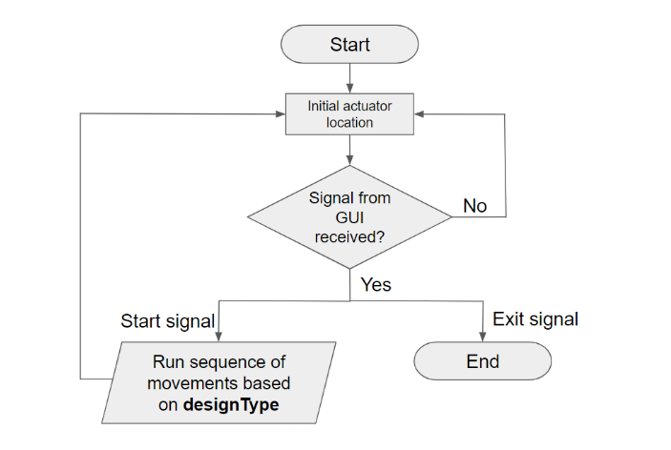
Actuator Control Flow Chart

Slide 5
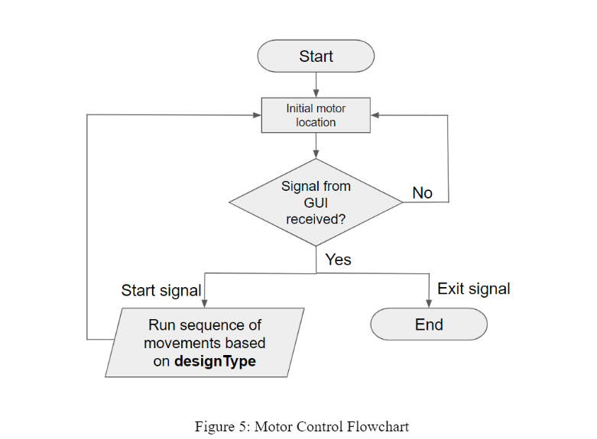
Motor Control Flow Chart

Slide 6
Claimed Deliverables
Refined physical prototype with servos and actuators integrated into the design
Demonstrate the motions for the tulip, heart, and fern designs with milk and coffee cup prototypes

Slide 7
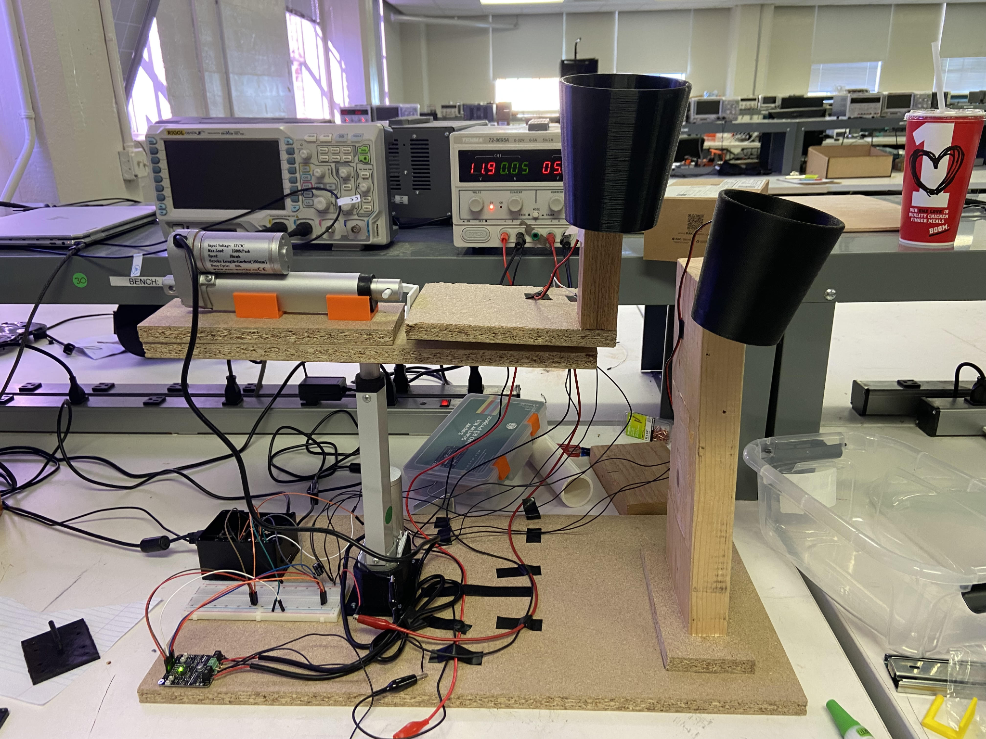
Implemented Prototype

Slide 8
Challenges/Bottlenecks
Twitching servo motors
Pouring of solid objects is hard to compare to liquids

